Slide 1
Electrochemistry for Materials Technology
8 - Nucleation and Growth
Effect of electroplating parameters

Slide 2
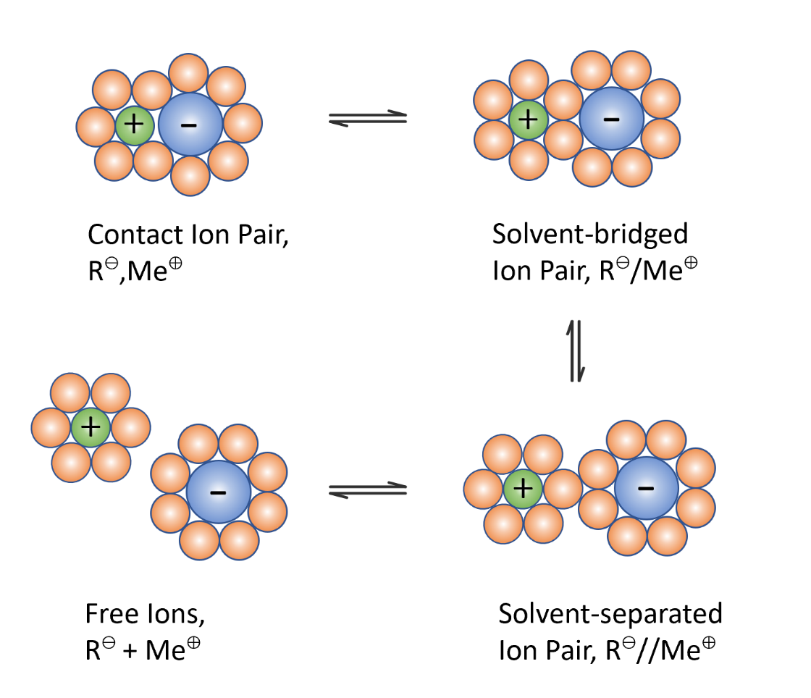

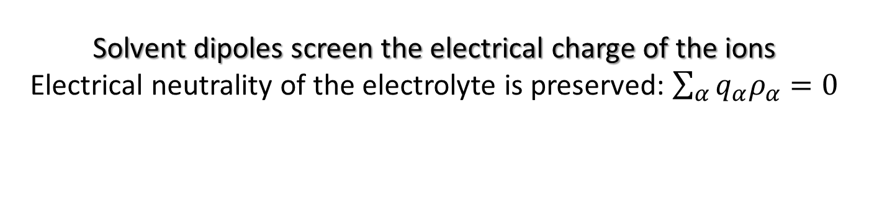
I) Solvation of ions
1) Dissolution of a metal salt in polar solvents
Solvent dipoles screen the electrical charge of the ions
Electrical neutrality of the electrolyte is preserved: $\sum_{α}{q_{α}ρ_{α}}=0$
with q the charge and $ρ$ the number density

Slide 3
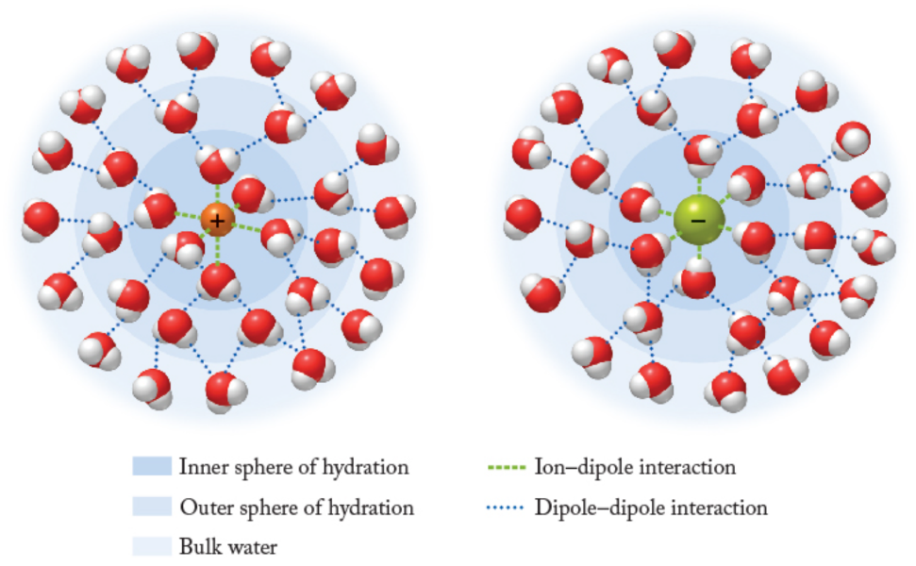
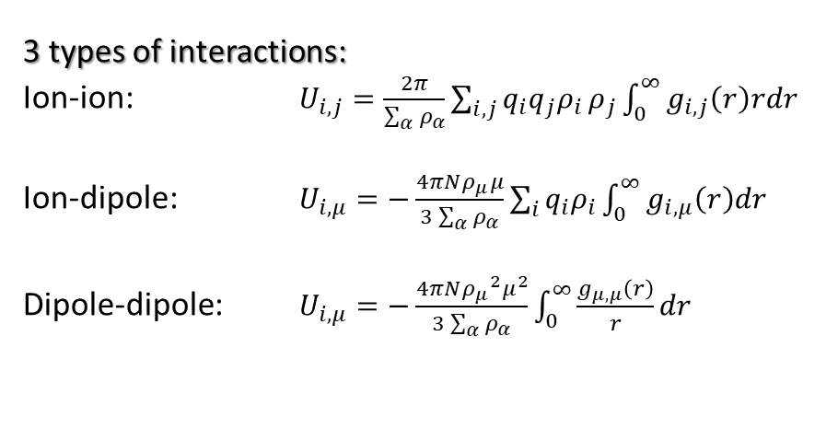
I) Solvation of ions
2) Ion solvation
3 types of interactions:
Ion-ion: $U_{i,j}=\frac{2π}{\sum_{α}{ρ_{α}}}\sum_{i,j}{q_{i}{q_{j}ρ}_{i}}ρ_{j}\int_{0}^{∞}{g_{i,j}\left(r\right)rdr}$
Ion-dipole: $U_{i,μ}=−\frac{4πNρ_{μ}μ}{3\sum_{α}{ρ_{α}}}\sum_{i}{q_{i}ρ_{i}}\int_{0}^{∞}{g_{i,μ}\left(r\right)dr}$
Dipole-dipole: $U_{i,μ}=−\frac{4πN{ρ_{μ}}^{2}μ^{2}}{3\sum_{α}{ρ_{α}}}\int_{0}^{∞}{\frac{g_{μ,μ}\left(r\right)}{r}dr}$
with g(r) the radial distribution function
A hard solvation sphere is formed
Metal cations are hydrated
Hydration number depends on the Pauling’s ionic radius

Slide 4
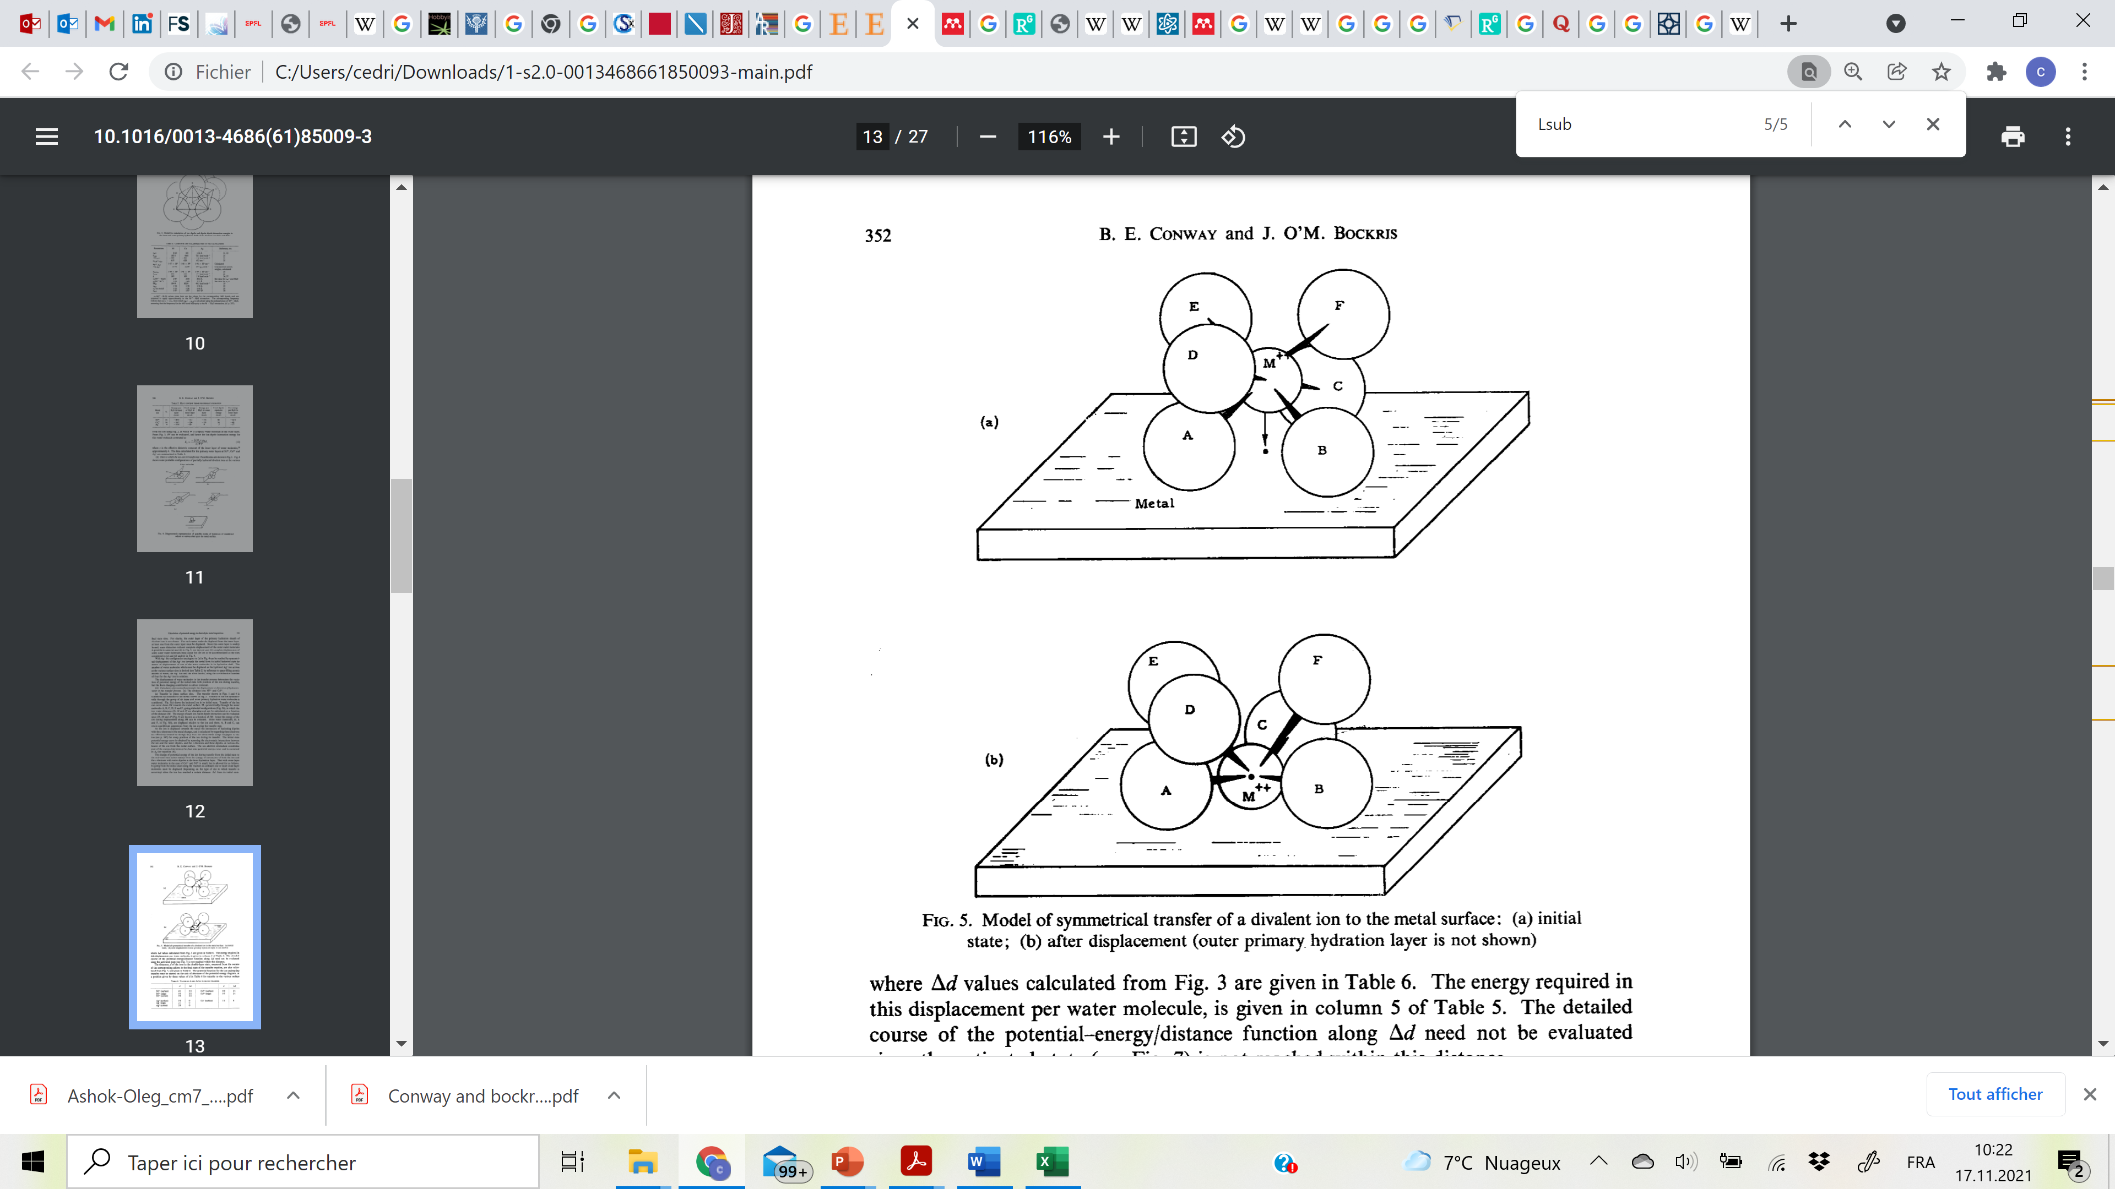
II) Cation-surface interaction
1) Adsorption on a planar surface
A negative potential is imposed to the substrate
Interactions cathode (-) — cations (+)
Displacement of the hydration shell and transfer of the cation to the surface
Symmetrical transfer
Cation transfer
Symmetrical transfer: only the outer solvation shell is displaced
Need to disrupt the inner shell to transfer the cation to the surface

Slide 5
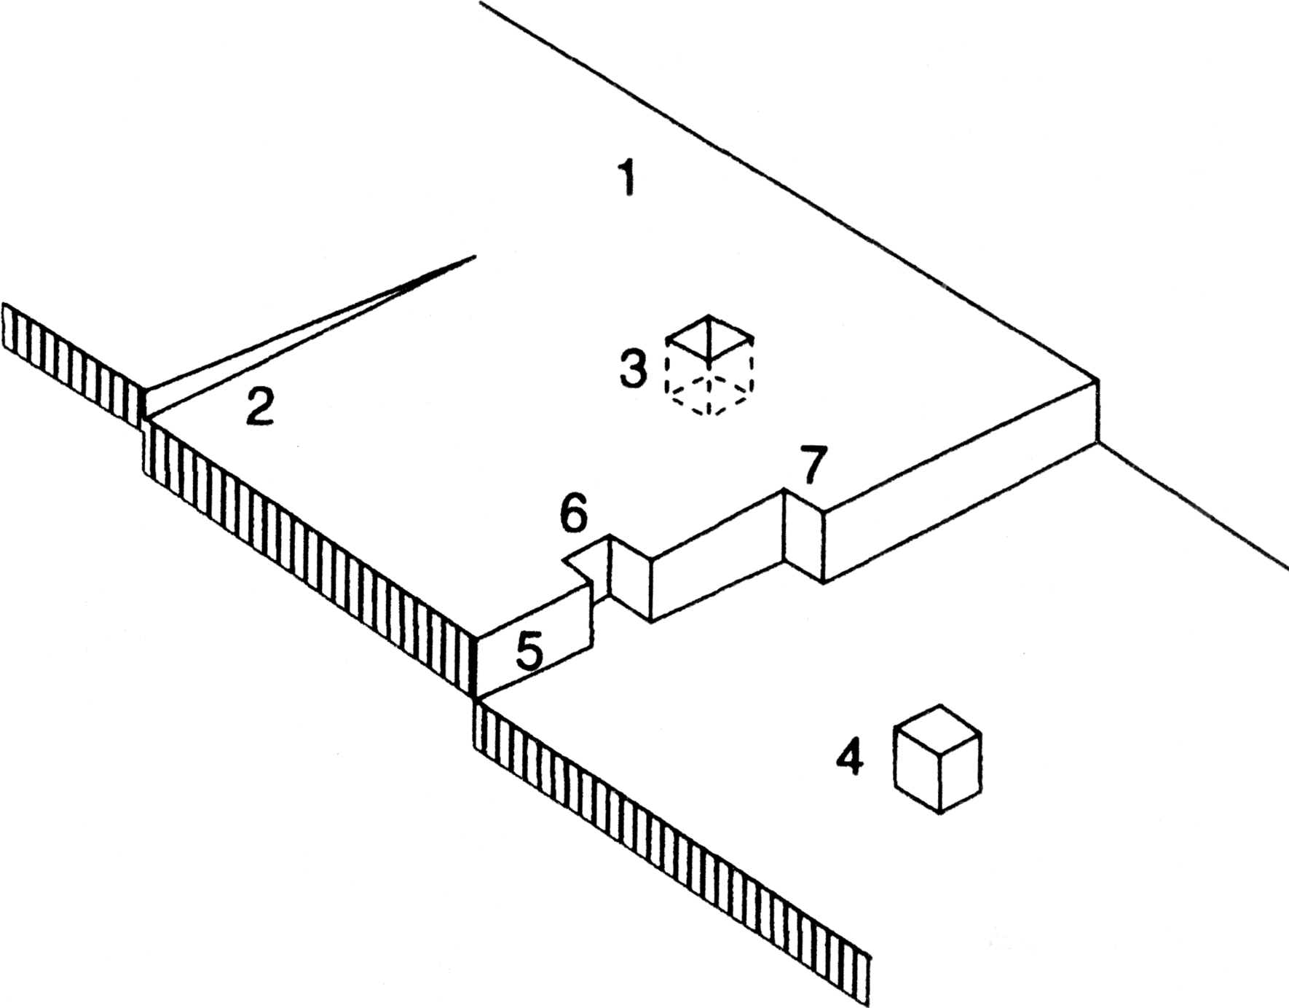
II) Cation-surface interaction
3) Real surfaces
Real surfaces are not ideal surfaces
Density of metal surface atoms 10¹⁵ cm⁻²
Density of dislocations 10⁴ – 10⁸ cm⁻²
Perfect flat face,terrace Emerging screw dislocation Vacancy in the terrace Atom on the terrace
A ledge: monoatomic step
Vacancy in the ledge
Kink: a ledge in the ledge
Simple defects

Slide 6
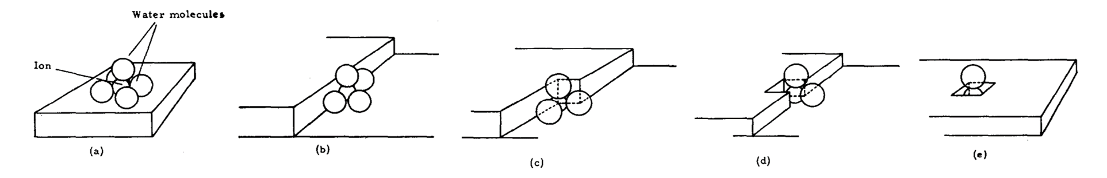
II) Cation-surface interaction
4) Different adsorption sites
Let us consider the initial state [M (H₂O)₆] ^{z+} an octahedral metal hydrate
Plane
Ledge
Ledge kink
Ledge vacancy
Plane vacancy
— H₂O
— 2H₂O
— 3H₂O
— 4H₂O
— 5H₂O
[M (H₂O)₅] ^{z+}
[M (H₂O)₄] ^{z+}
[M (H₂O)₃] ^{z+}
[M (H₂O)₂] ^{z+}
[M (H₂O)] ^{z+}

Slide 7
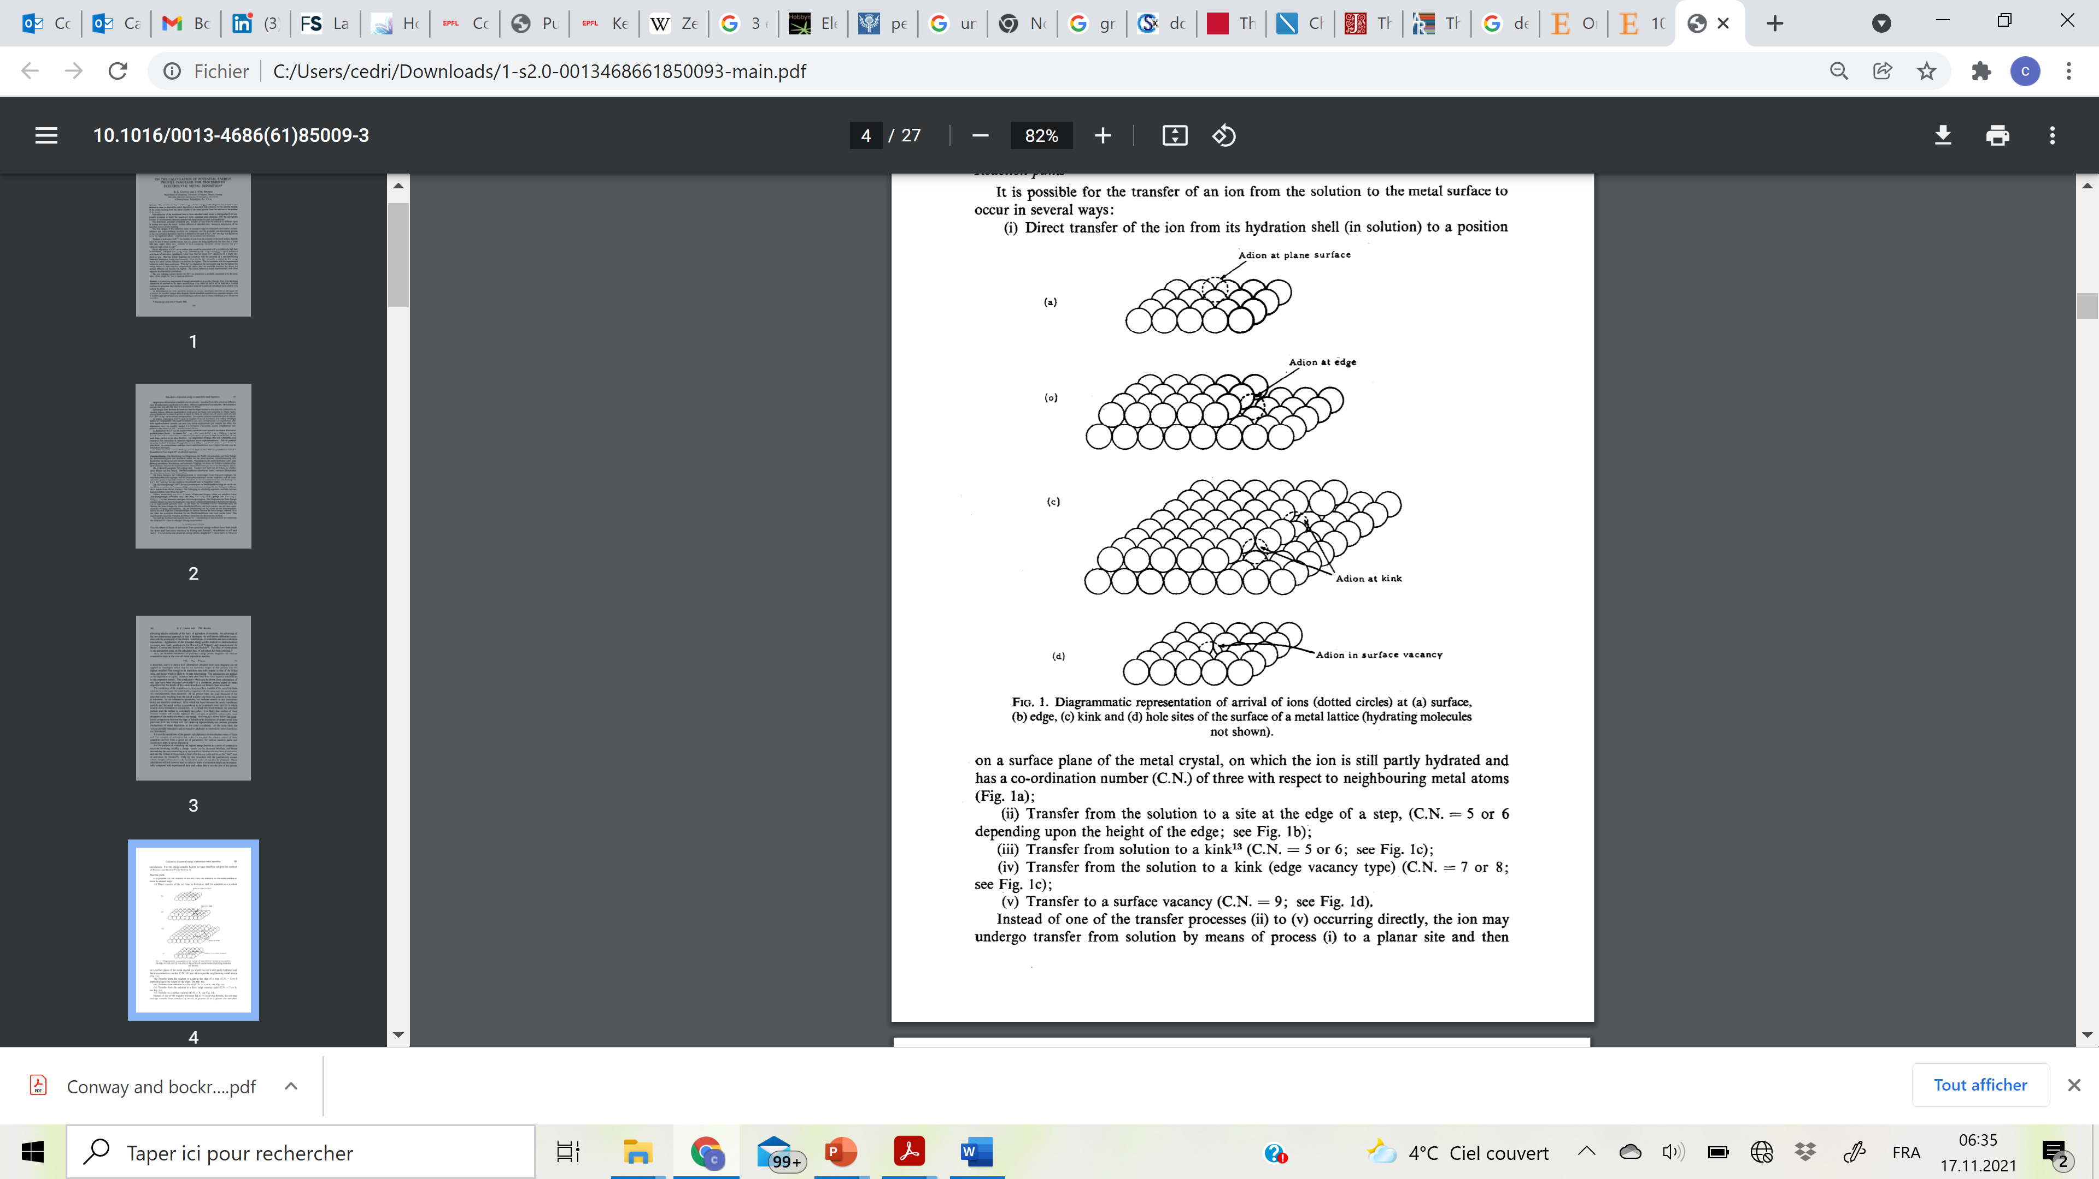
II) Cation-surface interaction
5) Coordination number = neighbouring metal atoms
Adion at a plane surface site: C.N.= 3
Adion at a monoatomic ledge site: C.N. = 5
Adion at a polyatomic ledge site: C.N. = 6
Adion at kink sites: C.N. = 5 or 6
Adion at edge vacancy sites: C.N. = 7 or 8
Adion at a surface vacancy: C.N. = 9

Slide 8
II) Cation-surface interaction
6) Consequence on the electrical activation energy
The electrical activation energy depends on surface site
$${ΔG}_{e,3}^{∗}<{ΔG}_{e,6}^{∗}<{ΔG}_{e,7}^{∗}≾{ΔG}_{e,5 }^{∗}≾{ΔG}_{e,2}^{∗}<{ΔG}_{e,4}^{∗}<{ΔG}_{e,1}^{∗}$$
$$C.N.:9 >8−7>6−5≥6−5≥ 5 > 4 > 3$$
Perfect flat face,terrace Emerging screw dislocation Vacancy in the terrace Adatom in the terrace
A ledge: monoatomic step
Vacancy in the ledge
Kink: a ledge in the ledge
Simple defects

Slide 9
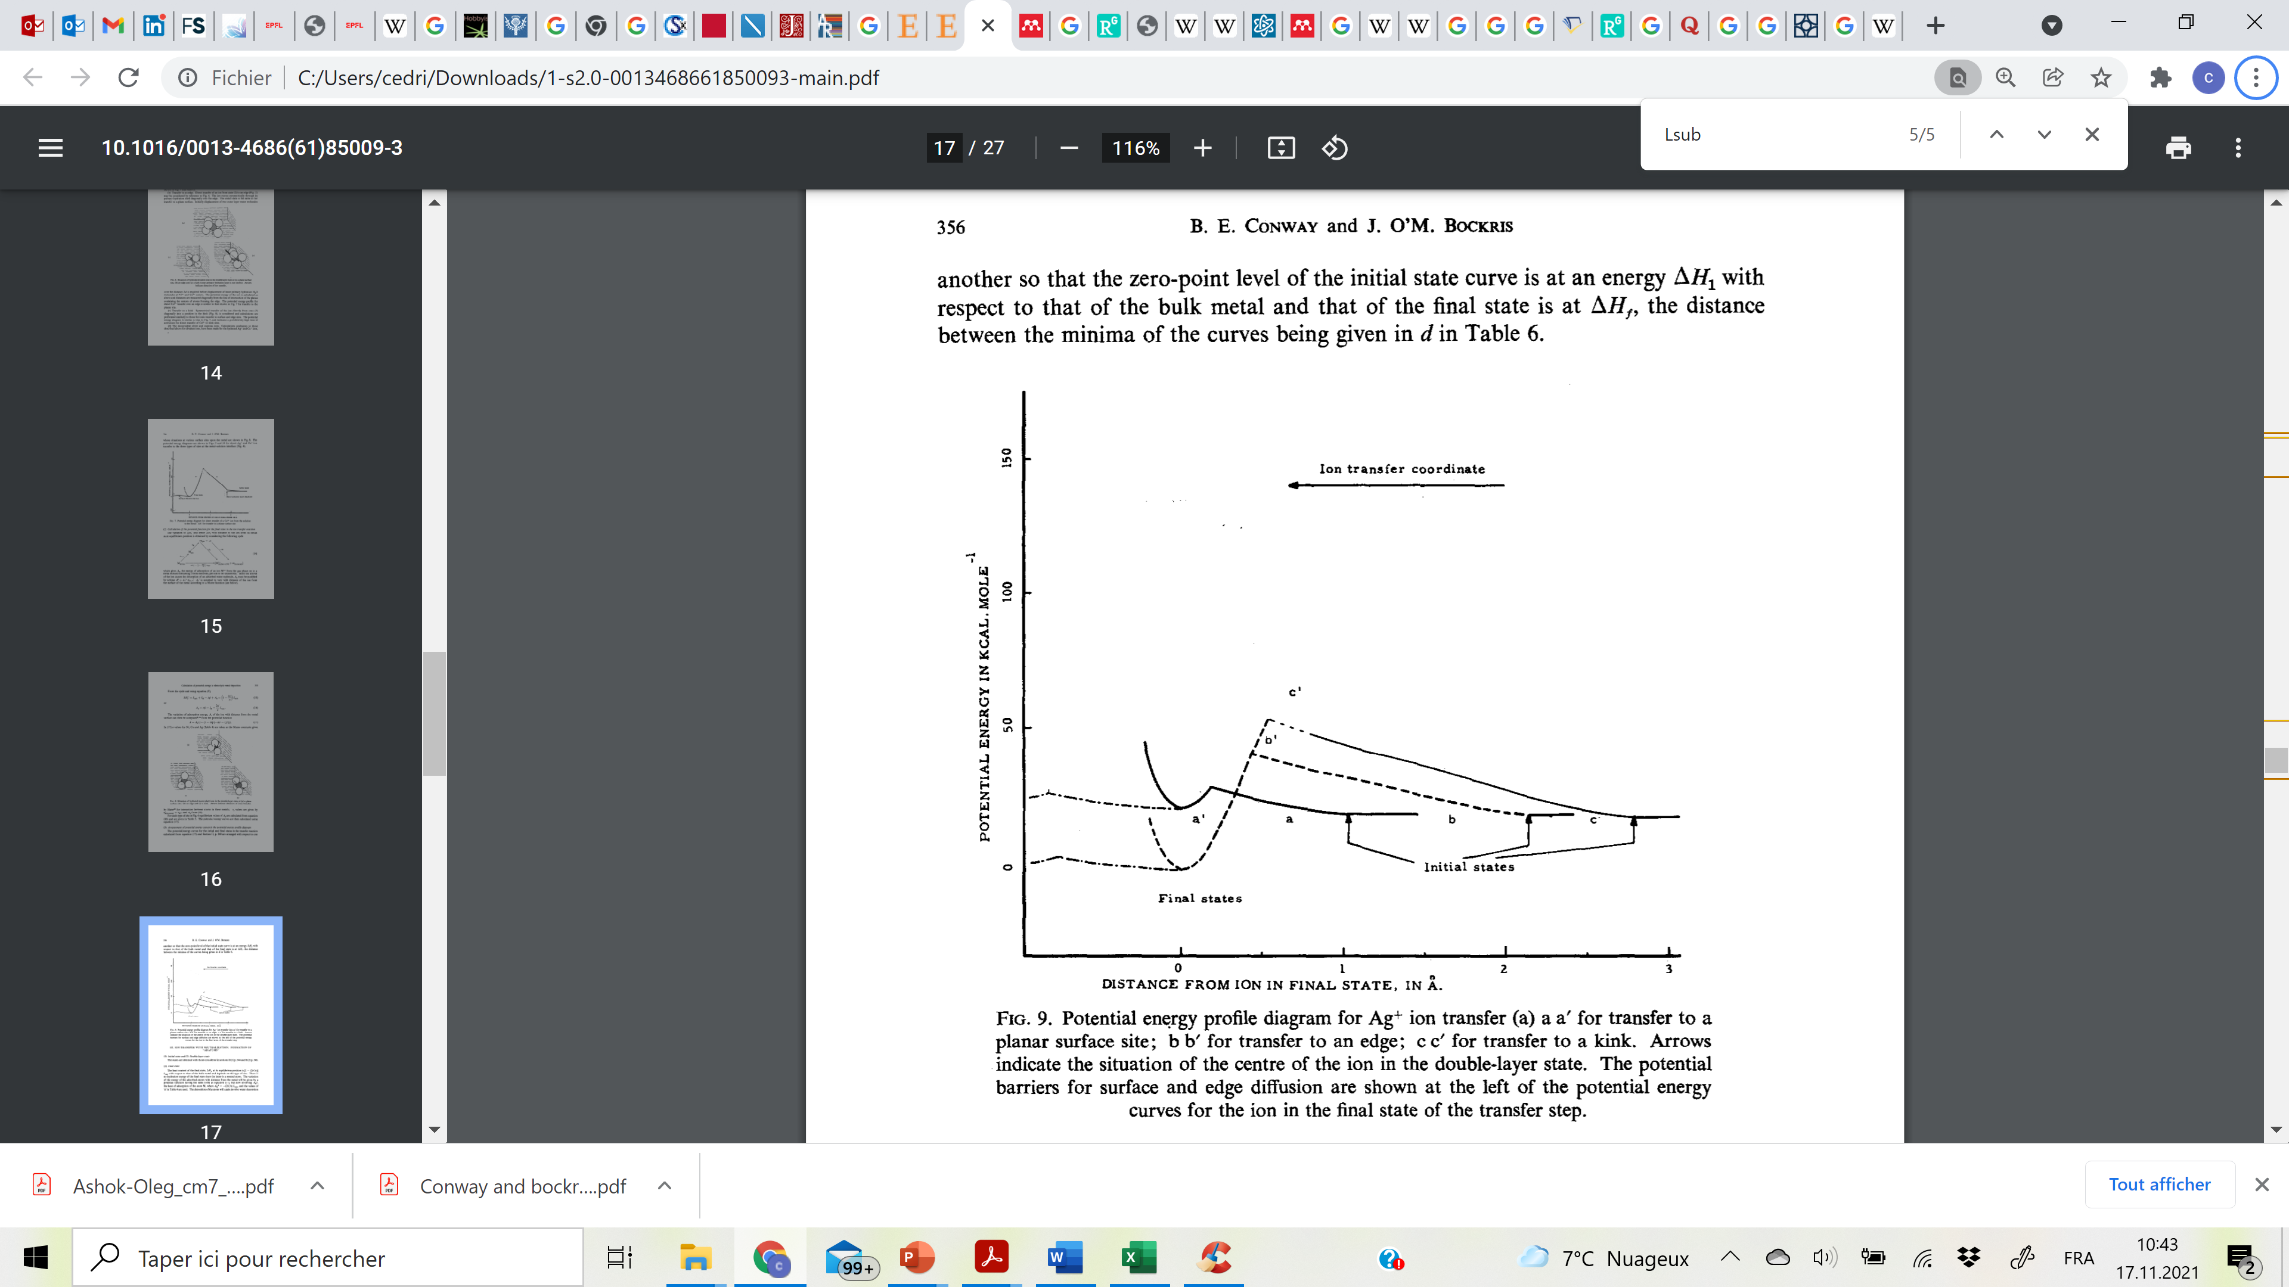
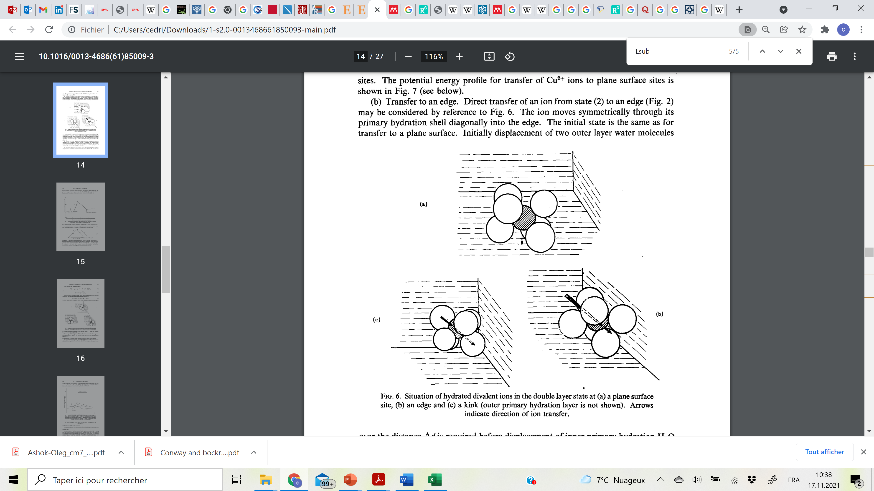
II) Cation-surface interaction
7) Potential energy considerations
Adsorption Energy barriers
Bockris et al.
Adion diffusion barrier
Energy barrier lowest for adsorption on planar surface
Final state most stable at a ledge

Slide 10
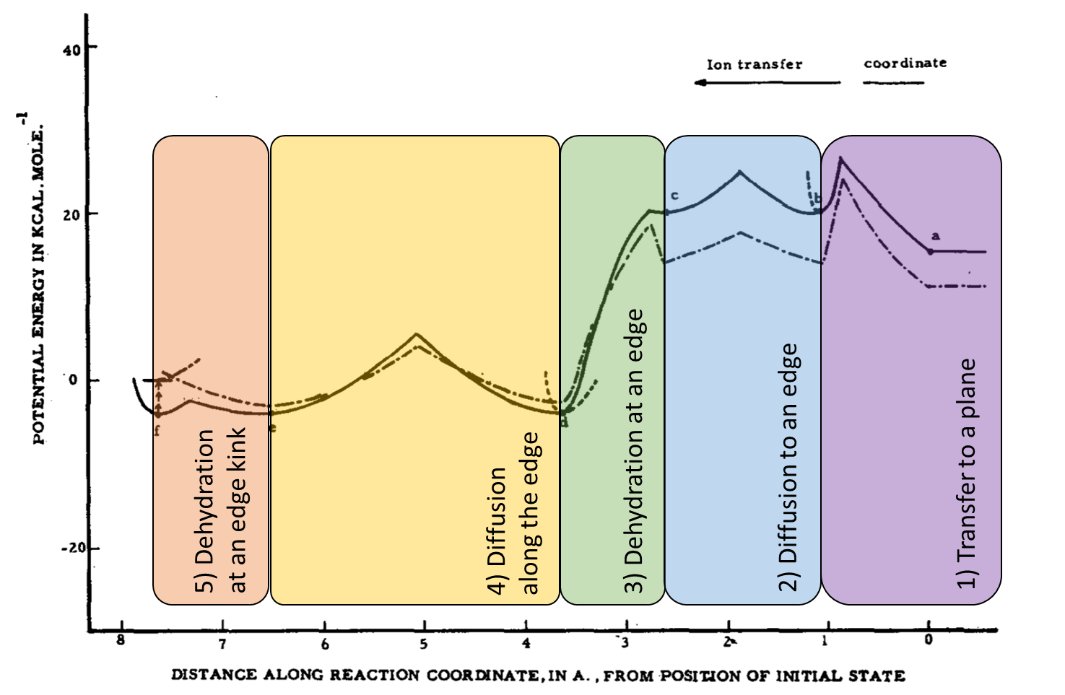
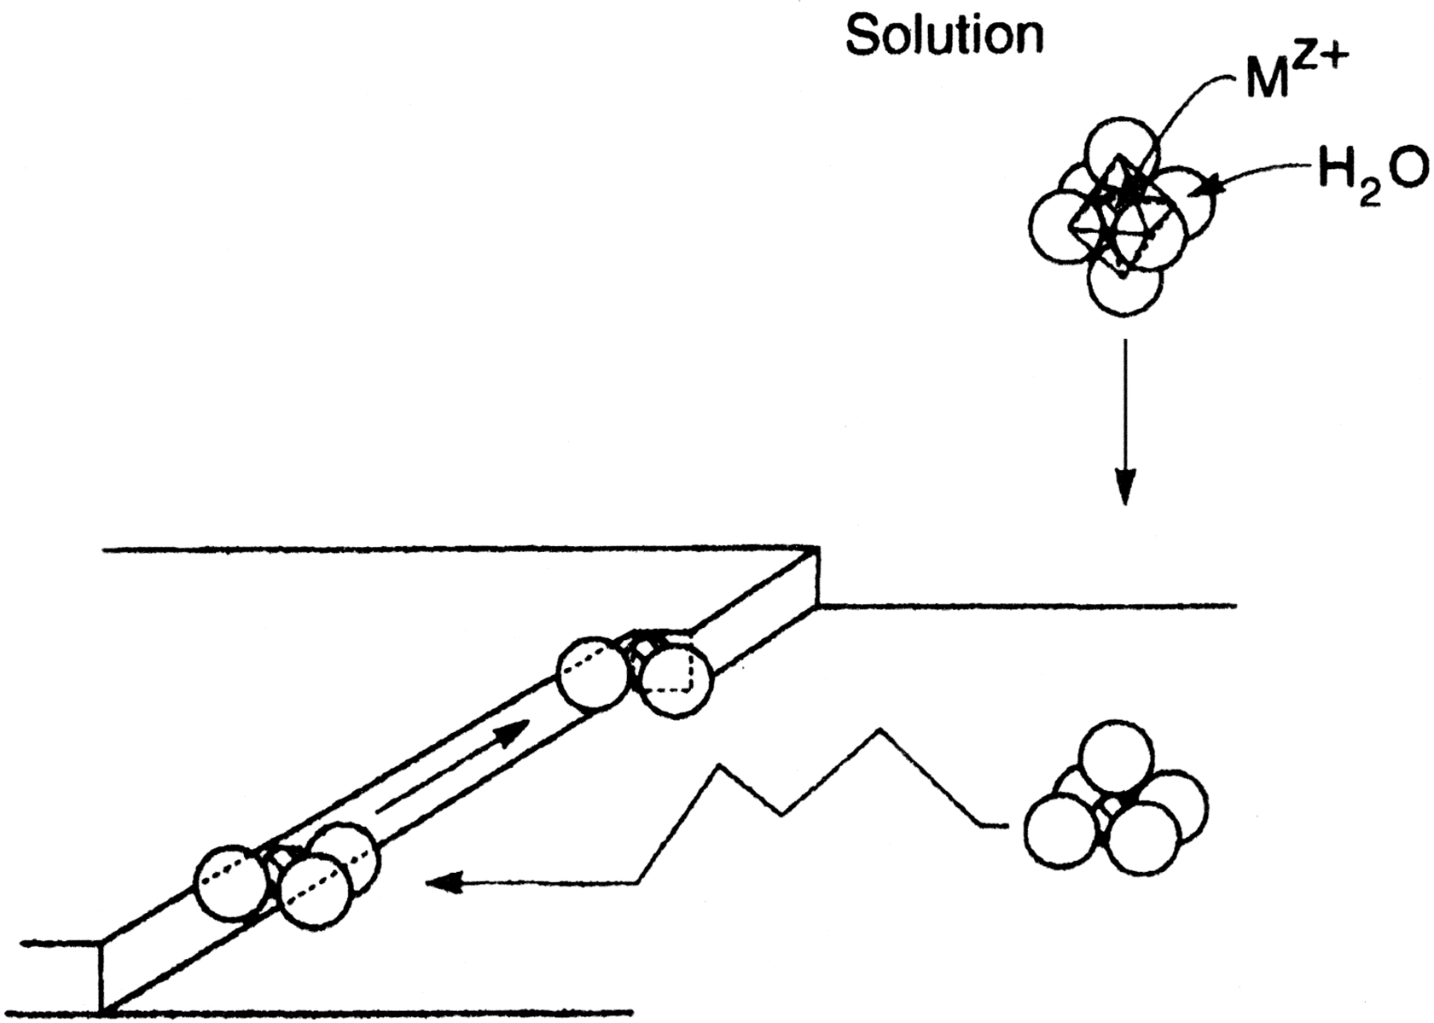
II) Cation-surface interaction
8) Most probable pathway
1
5
4
3
2
Dashed line = Free energy profile

Slide 11
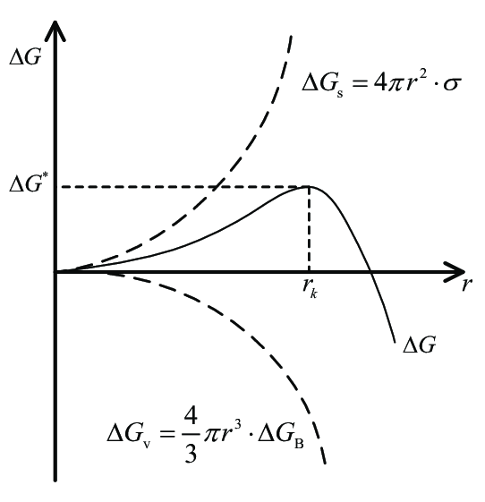
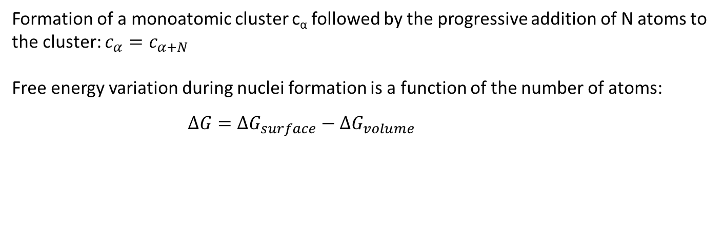
III) Nucleation and growth process
1) Homogeneous nucleation: spherical nucleus
Formation of a monoatomic cluster c_{α} followed by the progressive addition of N atoms to the cluster: $c_{α}=c_{α+N}$
Free energy variation during nuclei formation is a function of the number of atoms:
$$∆G={ΔG}_{surface}−{ΔG}_{volume}=σ_{s}S−Δμ\frac{V}{V_{m}}$$

Slide 12
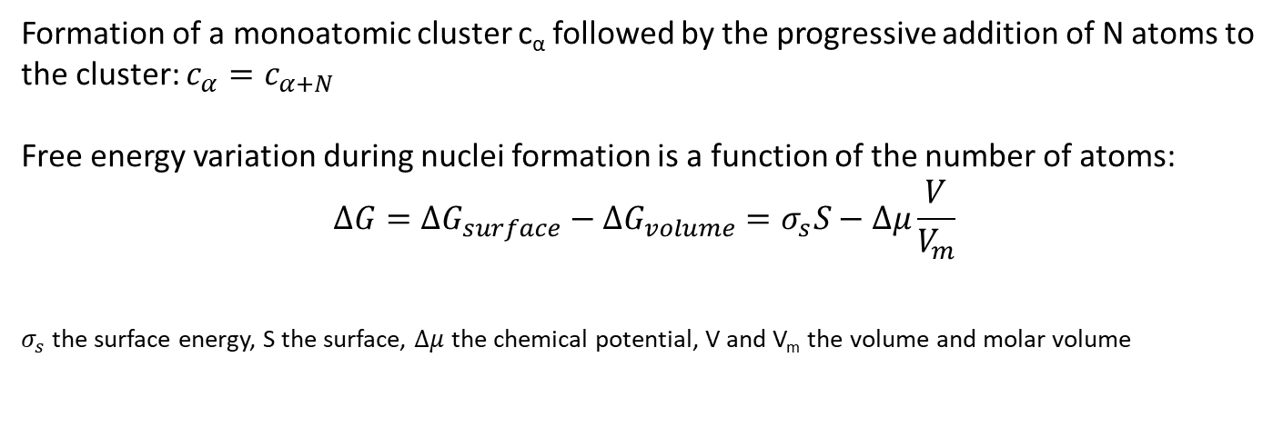


III) Nucleation and growth process
1) Homogeneous nucleation: spherical nucleus
Formation of a monoatomic cluster c_{α} followed by the progressive addition of N atoms to the cluster: $c_{α}=c_{α+N}$
Free energy variation during nuclei formation is a function of the number of atoms:
$$∆G={ΔG}_{surface}−{ΔG}_{volume}=σ_{s}S−Δμ\frac{V}{V_{m}}$$
$σ_{s}$the surface energy, S the surface, $Δμ$ the chemical potential, V and V_{m} the volume and molar volume
$≠f(η$)
$=f(η$)

Slide 13
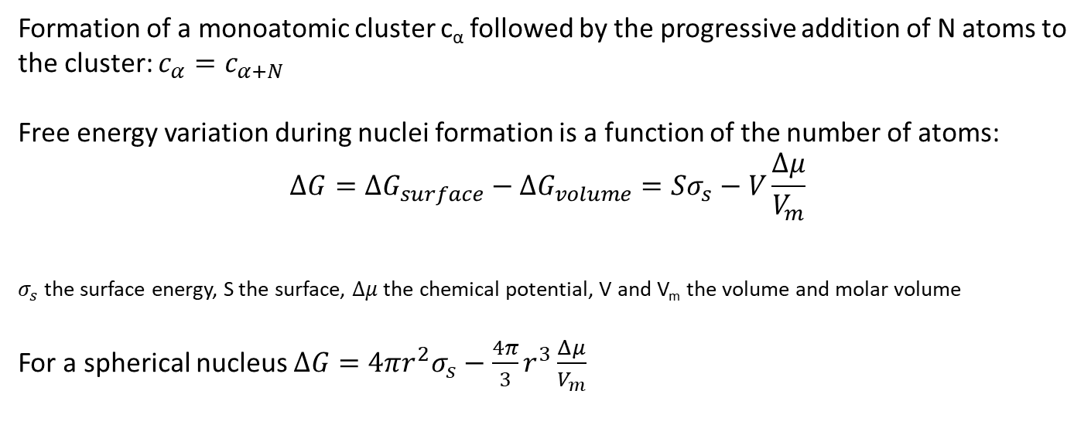
III) Nucleation and growth process
1) Homogeneous nucleation: spherical nucleus
Formation of a monoatomic cluster c_{α} followed by the progressive addition of N atoms to the cluster: $c_{α}=c_{α+N}$
Free energy variation during nuclei formation is a function of the number of atoms:
$$∆G={ΔG}_{surface}−{ΔG}_{volume}=Sσ_{s}−V\frac{Δμ}{V_{m}}$$
$σ_{s}$ the surface energy, S the surface, $Δμ$ the chemical potential, V and V_{m} the volume and molar volume
For a spherical nucleus $∆G=4πr^{2}σ_{s}−\frac{4π}{3}r^{3}\frac{Δμ}{V_{m}}$
$≠f(η$)
$=f(η$)

Slide 14
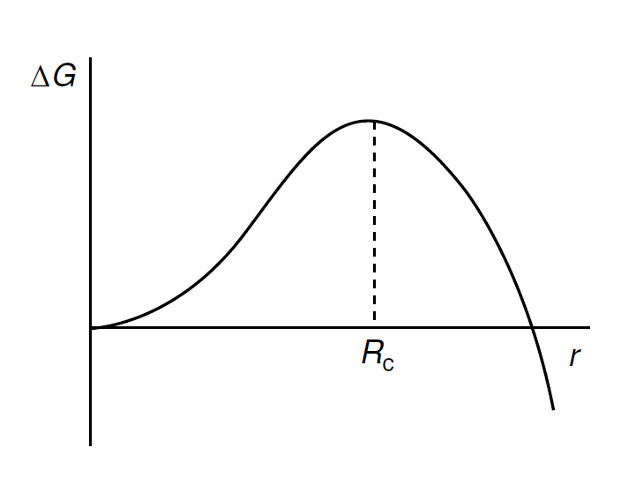
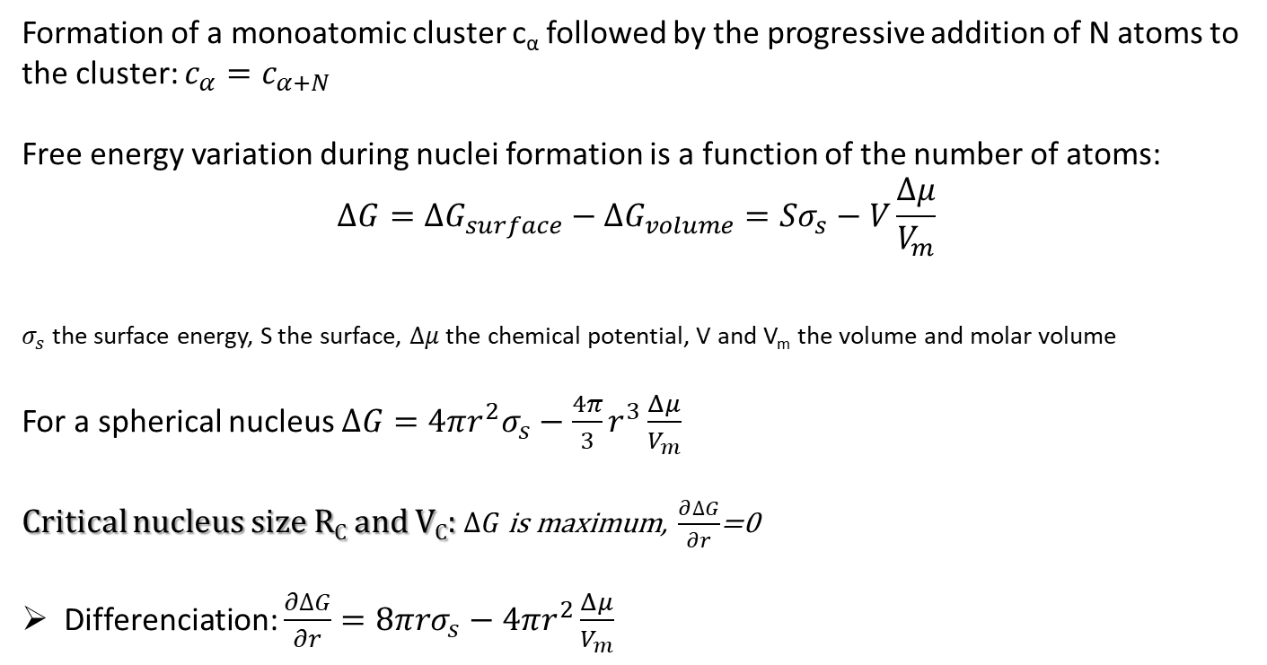

III) Nucleation and growth process
1) Homogeneous nucleation: spherical nucleus
Formation of a monoatomic cluster c_{α} followed by the progressive addition of N atoms to the cluster: $c_{α}=c_{α+N}$
Free energy variation during nuclei formation is a function of the number of atoms:
$$∆G={ΔG}_{surface}−{ΔG}_{volume}=Sσ_{s}−V\frac{Δμ}{V_{m}}$$
$σ_{s}$ the surface energy, S the surface, $Δμ$ the chemical potential, V and V_{m} the volume and molar volume
For a spherical nucleus $∆G=4πr^{2}σ_{s}−\frac{4π}{3}r^{3}\frac{Δμ}{V_{m}}$
Critical nucleus size R_{C} and V_{C}: $∆G$ is maximum, $\frac{∂∆G}{∂r}$=0
Differenciation: $\frac{∂∆G}{∂r}=8πrσ_{s}−4πr^{2}\frac{Δμ}{V_{m}}$
$≠f(η$)
$=f(η$)
Unstable → Stable
$${ΔG}_{C}$$
Nucleation → Growth
Free energy variation vs nucleus radius

Slide 15
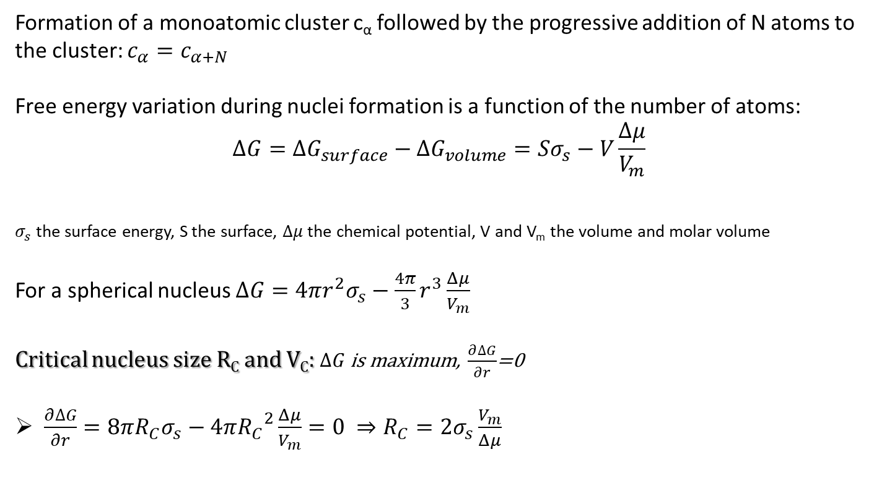
III) Nucleation and growth process
1) Homogeneous nucleation: spherical nucleus
Formation of a monoatomic cluster c_{α} followed by the progressive addition of N atoms to the cluster: $c_{α}=c_{α+N}$
Free energy variation during nuclei formation is a function of the number of atoms:
$$∆G={ΔG}_{surface}−{ΔG}_{volume}=Sσ_{s}−V\frac{Δμ}{V_{m}}$$
$σ_{s}$ the surface energy, S the surface, $Δμ$ the chemical potential, V and V_{m} the volume and molar volume
For a spherical nucleus $∆G=4πr^{2}σ_{s}−\frac{4π}{3}r^{3}\frac{Δμ}{V_{m}}$
Critical nucleus size R_{C} and V_{C}: $∆G$ is maximum, $\frac{∂∆G}{∂r}$=0
$\frac{∂∆G}{∂r}=8πR_{C}σ_{s}−4π{R_{C}}^{2}\frac{Δμ}{V_{m}}=0 ⇒R_{C}=2σ_{s}\frac{V_{m}}{Δμ}$
$≠f(η$)
$=f(η$)
Unstable → Stable
$${ΔG}_{C}$$
Nucleation → Growth
Free energy variation vs nucleus radius

Slide 16

III) Nucleation and growth process
1) Homogeneous nucleation: spherical nucleus
Formation of a monoatomic cluster c_{α} followed by the progressive addition of N atoms to the cluster: $c_{α}=c_{α+N}$
Free energy variation during nuclei formation is a function of the number of atoms:
$$∆G={ΔG}_{surface}−{ΔG}_{volume}=Sσ_{s}−V\frac{Δμ}{V_{m}}$$
$σ_{s}$ the surface energy, S the surface, $Δμ$ the chemical potential, V and V_{m} the volume and molar volume
For a spherical nucleus $∆G=4πr^{2}σ_{s}−\frac{4π}{3}r^{3}\frac{Δμ}{V_{m}}$
Critical nucleus size R_{C} and V_{C}: $∆G$ is maximum, $\frac{∂∆G}{∂r}$=0
$\frac{∂∆G}{∂r}=8πR_{C}σ_{s}−4π{R_{C}}^{2}\frac{Δμ}{V_{m}}=0 ⇒R_{C}=2σ_{s}\frac{V_{m}}{Δμ}$
hence $V_{C}=\frac{32π}{3}{\left(σ_{s}\frac{V_{m}}{Δμ}\right)}^{3}$ and ${ΔG}_{C}=\frac{16π}{3}{σ_{s}}^{3}{\left(\frac{V_{m}}{Δμ}\right)}^{2}=\frac{V_{c}}{2}\frac{∆μ}{V_{m}}$
$≠f(η$)
$=f(η$)
Unstable → Stable
$${ΔG}_{C}$$
Nucleation → Growth
Free energy variation vs nucleus radius

Slide 17
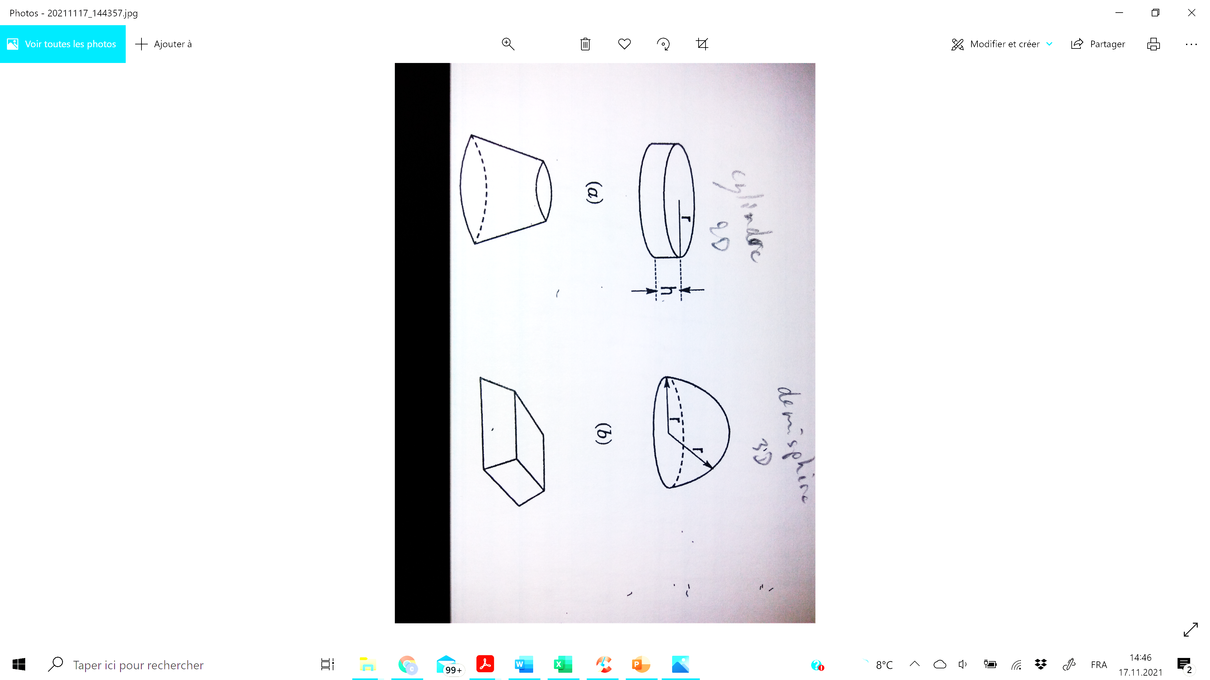
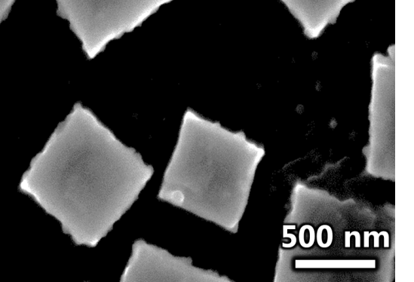

III) Nucleation and growth process
2) Homogeneous nucleation: real nuclei
Expression of the critical volume still holds: $V_{C}=Γ{\left(σ_{s}\frac{V_{m}}{Δμ}\right)}^{3}$
with $Γ$ the shape factor ($Γ_{sphere}=\frac{32π}{3},Γ_{cube}=64$)
Cylindrical
Hemispherical
Conical
Facetted
Anisotropy of the crystal properties
Growth on high surface energy crystal plane is favored

Slide 18
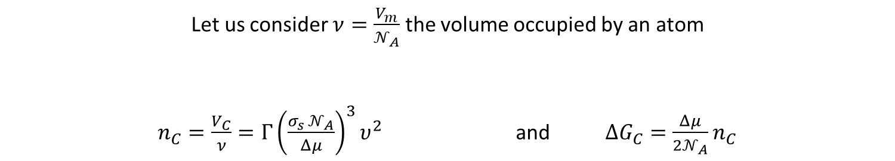
III) Nucleation and growth process
2) Homogeneous nucleation: real nuclei
Expression of the critical volume still holds: $V_{C}=Γ{\left(σ_{s}\frac{V_{m}}{Δμ}\right)}^{3}$
with $Γ$ the shape factor ($Γ_{sphere}=\frac{32π}{3},Γ_{cube}=64$)
Cylindrical
Hemispherical
Conical
Facetted
More convenient to determine the critical number of atoms n_{C} than R_{C}
Let us consider $ν=\frac{V_{m}}{𝒩_{A}}$ the volume occupied by an atom
$n_{C}=\frac{V_{C}}{ν}=Γ{\left(\frac{σ_{s} 𝒩_{A}}{Δμ}\right)}^{3}υ^{2}$ and $ΔG_{C}=\frac{Δμ}{2𝒩_{A}}n_{C}$

Slide 19
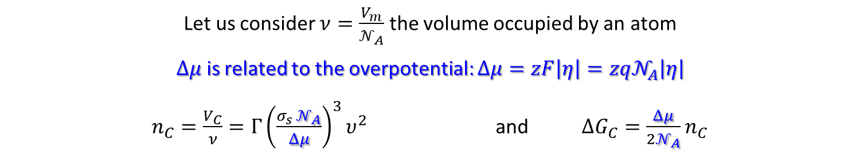
III) Nucleation and growth process
2) Homogeneous nucleation: real nuclei
Expression of the critical volume still holds: $V_{C}=Γ{\left(σ_{s}\frac{V_{m}}{Δμ}\right)}^{3}$
with $Γ$ the shape factor ($Γ_{sphere}=\frac{32π}{3},Γ_{cube}=64$)
Cylindrical
Hemispherical
Conical
Facetted
More convenient to determine the critical number of atoms n_{C} than R_{C}
Let us consider $ν=\frac{V_{m}}{𝒩_{A}}$ the volume occupied by an atom
$Δμ$ is related to the overpotential: $Δμ=zF\left|η\right|=zq𝒩_{A}\left|η\right|$
$n_{C}=\frac{V_{C}}{ν}=Γ{\left(\frac{σ_{s} 𝒩_{A}}{Δμ}\right)}^{3}υ^{2}$ and $ΔG_{C}=\frac{Δμ}{2𝒩_{A}}n_{C}$

Slide 20
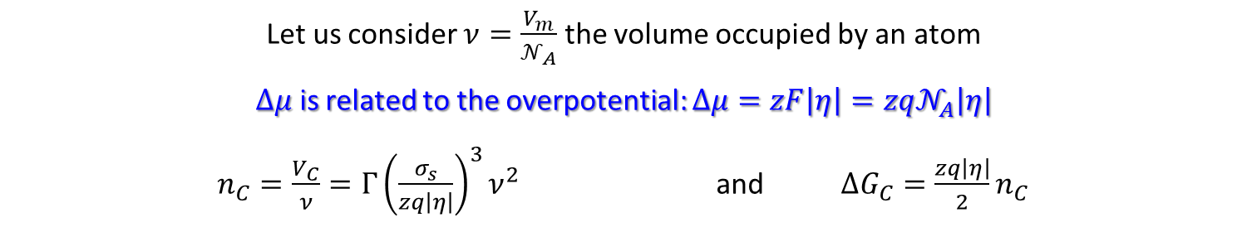
III) Nucleation and growth process
2) Homogeneous nucleation: real nuclei
Expression of the critical volume still holds: $V_{C}=Γ{\left(σ_{s}\frac{V_{m}}{Δμ}\right)}^{3}$
with $Γ$ the shape factor ($Γ_{sphere}=\frac{32π}{3},Γ_{cube}=64$)
Cylindrical
Hemispherical
Conical
Facetted
More convenient to determine the critical number of atoms n_{C} than R_{C}
Let us consider $ν=\frac{V_{m}}{𝒩_{A}}$ the volume occupied by an atom
$Δμ$ is related to the overpotential: $Δμ=zF\left|η\right|=zq𝒩_{A}\left|η\right|$
$n_{C}=\frac{V_{C}}{ν}=Γ{\left(\frac{σ_{s}}{zq\left|η\right|}\right)}^{3}ν^{2}$ and $ΔG_{C}=\frac{zq\left|η\right|}{2}n_{C}$
Increasing the overpotential decreases the critical size of nuclei !!!

Slide 21
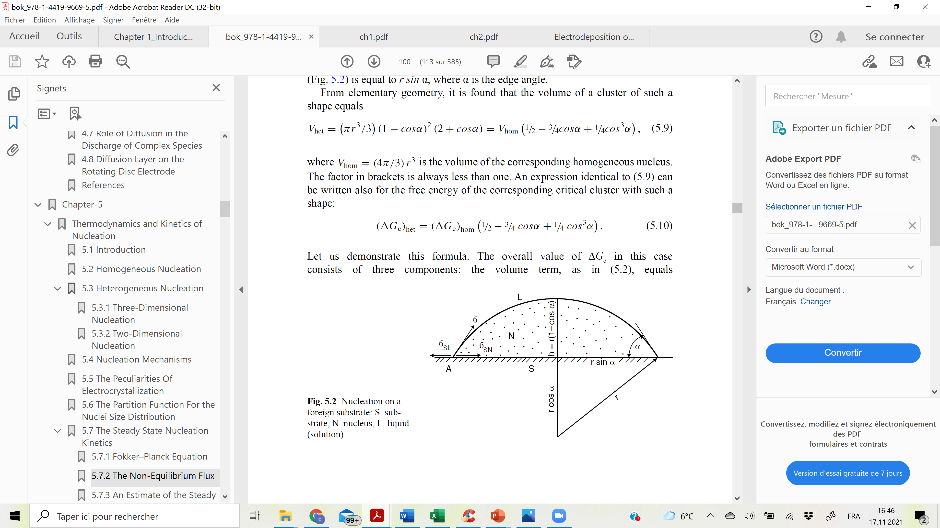
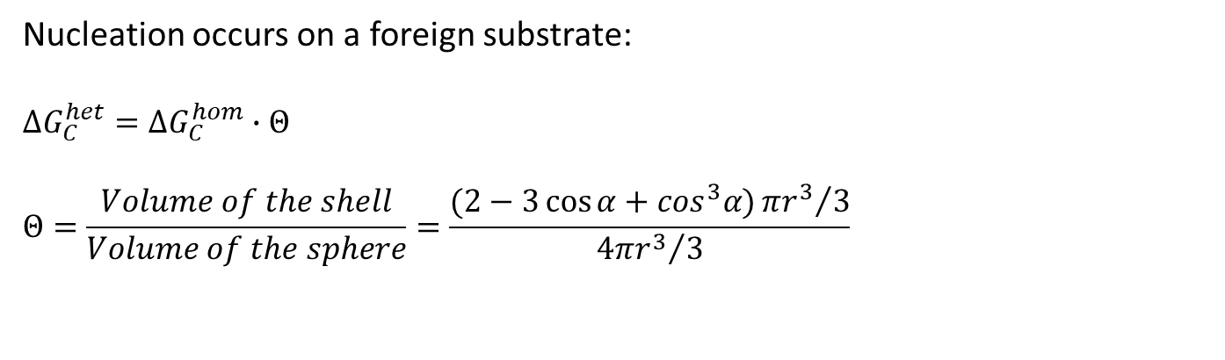
III) Nucleation and growth process
3) Heterogeneous 3D nucleation:
Nucleation occurs on a foreign substrate:
$$ΔG_{C}^{het}=ΔG_{C}^{hom}∙Θ$$
$$Θ=\frac{Volume of the shell}{Volume of the sphere}=\frac{(2−3\cos{α}+\cos^{3}α){πr^{3}}/3}{{4πr^{3}}/3}$$

Slide 22

III) Nucleation and growth process
3) Heterogeneous 3D nucleation:
Nucleation occurs on a foreign substrate:
$$ΔG_{C}^{het}=ΔG_{C}^{hom}∙Θ$$
$$Θ=\frac{Volume of the shell}{Volume of the sphere}=\frac{(2−3\cos{α}+\cos^{3}α){πr^{3}}/3}{{4πr^{3}}/3}$$
The contact angle is related to the surface energies via the Young equation:
$$Θ=\frac{2σ_{s}{−σ}_{Ad}}{2σ_{s}}=\frac{Δσ}{2σ_{s}}<1$$
Surface
Adhesion
$n_{C}=\frac{V_{C}}{ν}=\frac{16π}{3}\frac{{σ_{s}}^{2}Δσ}{{\left(zq\left|η\right|\right)}^{3}}ν^{2}$ and ${ΔG_{C}}^{3D}=\frac{zq\left|η\right|}{2}n_{C}$
Stronger adhesion decreases the critical size of nuclei !!!

Slide 23

III) Nucleation and growth process
4) Heterogeneous 2D nucleation:
Nucleation occurs on a foreign substrate (only a few atoms thick):
$$ΔG= σ_{s}S − Δμ\frac{V}{V_{m}}$$
$$ΔG=\left\{πr^{2}Δσ+2πraσ_{s}\right\}−\left\{πr^{2}a\frac{zFη}{V_{m}}\right\}$$
r
a

Slide 24

III) Nucleation and growth process
4) Heterogeneous 2D nucleation:
Nucleation occurs on a foreign substrate (only a few atoms thick):
$$ΔG= σ_{s}S − Δμ\frac{V}{V_{m}}$$
$$ΔG=\left\{πr^{2}Δσ+2πraσ_{s}\right\}−\left\{πr^{2}a\frac{zFη}{V_{m}}\right\}$$
$r_{c}=\frac{{V_{m}aσ}_{s}}{zF|η|a−V_{m}Δσ}$ and ${ΔG_{C}}^{2D}=\frac{π{σ_{s}}^{2}νa^{2}}{zq|η|a−νΔσ}$
r
a
The critical size of nuclei decreases for higher overpotential and stronger adhesion !!!

Slide 25


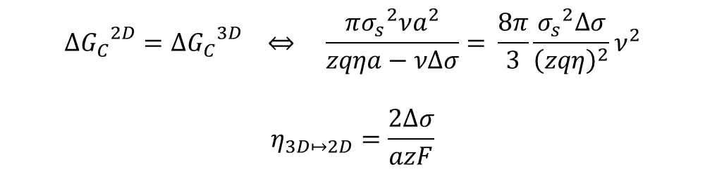
III) Nucleation and growth process
5) Nucleation mechanism:
Weak adhesion: $Δσ>0$
$$σ_{Ad}<{2σ}_{s}$$
$${ΔG_{C}}^{2D}={ΔG_{C}}^{3D} ⇔ \frac{π{σ_{s}}^{2}νa^{2}}{zqηa−νΔσ}= \frac{8π}{3}\frac{{σ_{s}}^{2}Δσ}{{\left(zqη\right)}^{2}}ν^{2}$$
$$η_{3D↦2D}=\frac{2Δσ}{azF}$$

Slide 26
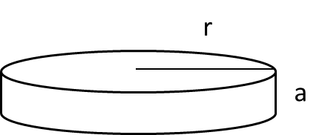
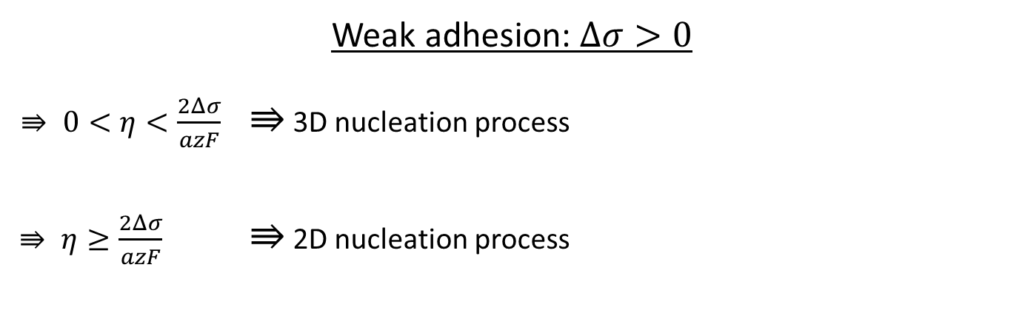
III) Nucleation and growth process
5) Nucleation mechanism:
Weak adhesion: $Δσ>0$
$⇛ 0<η<\frac{2Δσ}{azF}$ $⇛$ 3D nucleation process
$⇛ η≥\frac{2Δσ}{azF}$ $⇛$ 2D nucleation process
$$σ_{Ad}<{2σ}_{s}$$

Slide 27
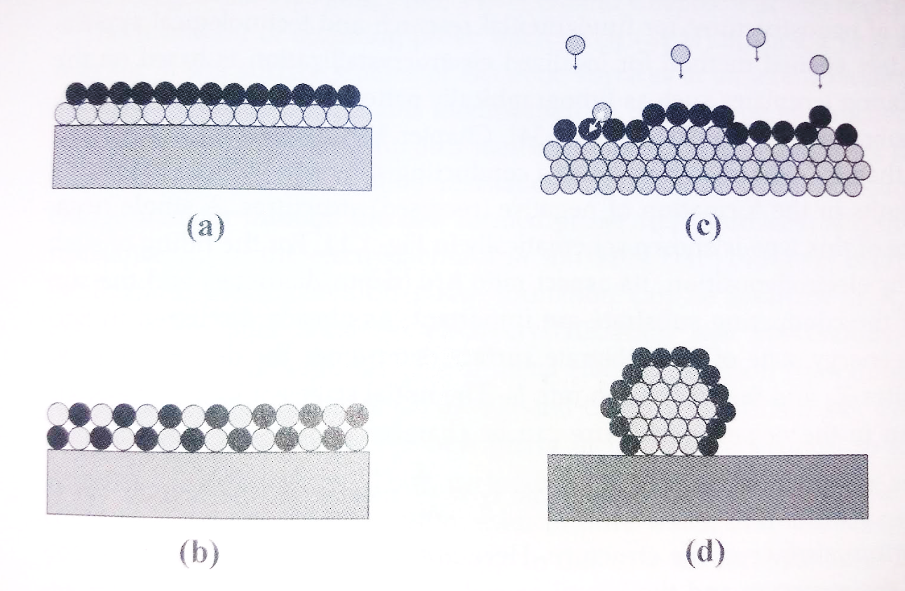


III) Nucleation and growth process
5) Nucleation mechanism:
Weak adhesion: $Δσ>0$
$⇛ 0<η<\frac{2Δσ}{azF}$ $⇛$ 3D nucleation process
$⇛ η≥\frac{2Δσ}{azF}$ $⇛$ 2D nucleation process
Strong adhesion: $Δσ<0$
$⇛\frac{Δσ}{azF}<η<0$ $⇛$ 2D nucleation can occur above E_{eq}
Limited to 1 or 2 monolayers
Enables electrochemical atomic layer epitaxy (ECALE)
$$σ_{Ad}<{2σ}_{s}$$
$$σ_{Ad}>{2σ}_{s}$$
Underpotential Deposition (UPD)

Slide 28
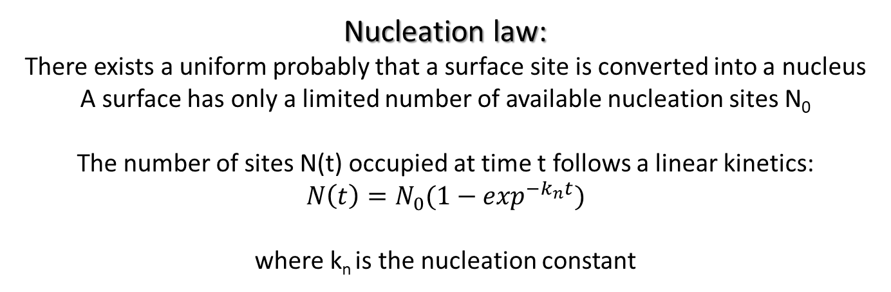
III) Nucleation and growth process
6) Nucleation kinetics
Nucleation law:
There exists a uniform probably that a surface site is converted into a nucleus
A surface has only a limited number of available nucleation sites N₀
The number of sites N(t) occupied at time t follows a linear kinetics:
$$N\left(t\right)=N_{0}(1−\exp^{{−k}_{n}t})$$
where k_{n} is the nucleation constant

Slide 29

III) Nucleation and growth process
6) Nucleation kinetics
Nucleation law:
There exist a uniform probably that a surface site is converted into a nucleus
A surface has only a limited number of available nucleation sites N₀
The number of sites N(t) occupied at time t follows a linear kinetics:
$$N\left(t\right)=N_{0}(1−\exp^{{−k}_{n}t})$$
where the nucleation constant k_{n} strongly depends on i/η
$$k_{n} is large ⟹fast nucleation⟹N\left(t=τ\right)=N_{0}$$
Instantaneous nucleation: all sites are occupied in a short induction time τ
$$k_{n} is small⟹slow nucleation⟹N\left(t\right)=N_{0}k_{n}t$$
Progressive nucleation: site occupation is linear with time

Slide 30

III) Nucleation and growth process
6) Growth of single nucleus
The growth rate normal to a surface $R\left(t\right)=\frac{iV_{m}t}{zF}$
Hemispherical 3D cluster
$I\left(t\right)={2πR(t)}^{2}i$ with the hemisphere radius: $R\left(t\right)=\frac{iV_{m}t}{zF}$
thus $I\left(t\right)={2π{\left(\frac{V_{m}t}{zF}\right)}^{2}i}^{3}=f\left(t^{2}\right)$
Cylindrical 2D cluster
$I\left(t\right)=2πaR\left(t\right)i$ with the cylinder radius: $R\left(t\right)=\frac{iV_{m}t}{zF}$
thus $I\left(t\right)={2π\frac{V_{m}t}{zF}i}^{2}=f\left(t\right)$

Slide 31
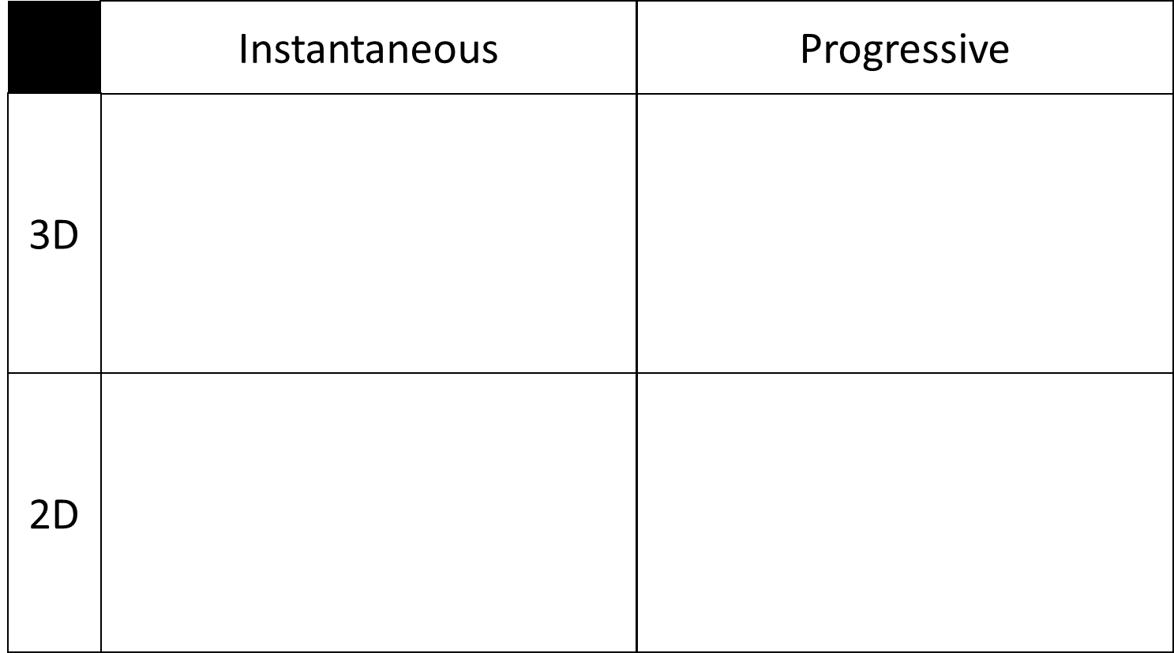


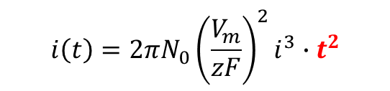

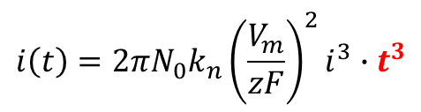
III) Nucleation and growth process
6) Nucleation models
$$N\left(t=τ\right)=N_{0}$$
$$N\left(t\right)=N_{0}k_{n}t$$
$$i\left(t\right)={2πN_{0}{\left(\frac{V_{m}}{zF}\right)}^{2}i}^{3}∙t^{2}$$
$$i\left(t\right)={2πN_{0}k_{n}{\left(\frac{V_{m}}{zF}\right)}^{2}i}^{3}∙t^{3}$$
$$i\left(t\right)={2πN_{0}\frac{V_{m}}{zF}i}^{2}∙t$$
$$i\left(t\right)={2πN_{0}k_{n}\frac{V_{m}}{zF}i}^{2}∙t^{2}$$
t < t_{max}: no mass transfer limitation, no overlapping

Slide 32
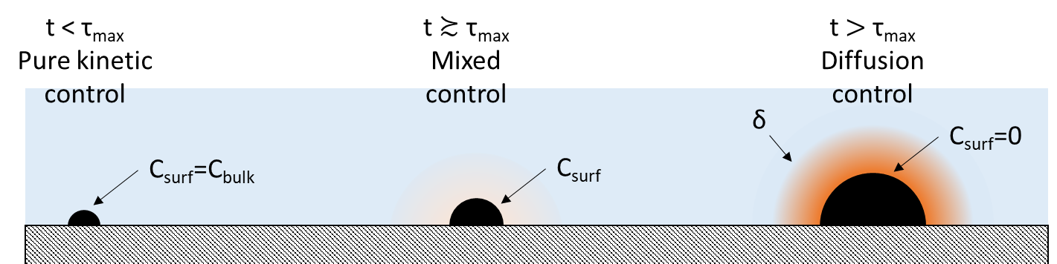
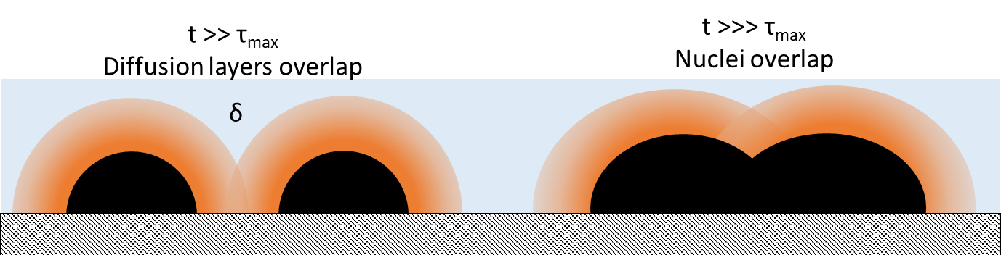
III) Nucleation and growth process
6) Nucleation models

Slide 33

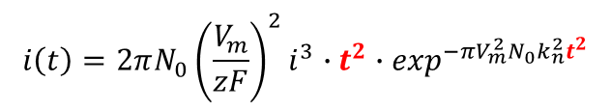


III) Nucleation and growth process
6) Nucleation models
Accounting for overlapping: Bewick, Scharifker and Hills (1962, 1983)
$$i\left(t\right)={2πN_{0}{\left(\frac{V_{m}}{zF}\right)}^{2}i}^{3}∙t^{2}∙\exp^{{−πV}_{m}^{2}N_{0}k_{n}^{2}t^{2}}$$
$i\left(t\right)={2πN_{0}k_{n}{\left(\frac{V_{m}}{zF}\right)}^{2}i}^{3}∙t^{3}$ ${∙exp}^{−\frac{{πV_{m}^{2}N}_{0}k_{n}^{2}t^{3}}{3}}$
$$i\left(t\right)={2πN_{0}\frac{V_{m}}{zF}i}^{2}∙t∙\exp^{{−πV}_{m}^{2}N_{0}k_{n}^{2}t^{2}}$$
$$i\left(t\right)={2πN_{0}k_{n}\frac{V_{m}}{zF}i}^{2}∙t^{2}{∙exp}^{−\frac{{πV_{m}^{2}N}_{0}k_{n}^{2}t^{3}}{3}}$$

Slide 34
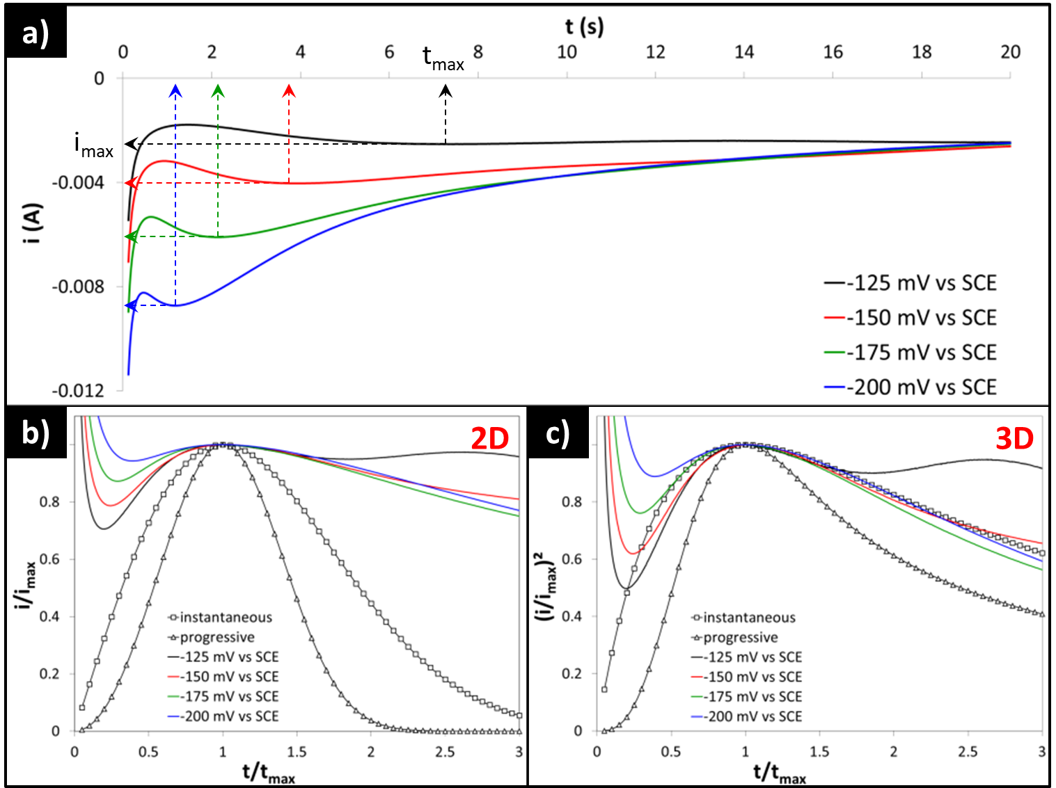
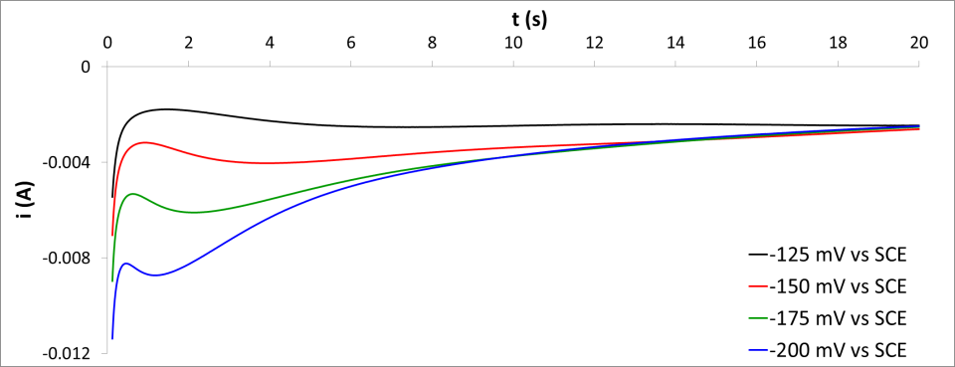
III) Nucleation and growth process
6) Nucleation models
DL charge

Slide 35
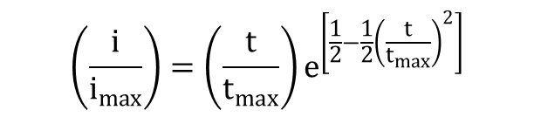
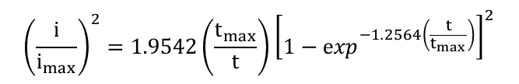
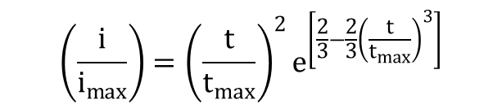
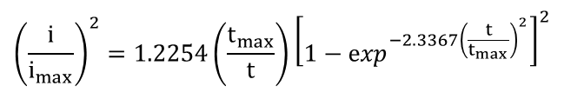
III) Nucleation and growth process
6) Nucleation models
Accounting for overlapping: Bewick, Scharifker and Hills (1962, 1983)
$${\left(\frac{i}{i_{max}}\right)}^{2}=1.9542\left(\frac{t_{max}}{t}\right){\left[1−\exp^{−1.2564\left(\frac{t}{t_{max}}\right)}\right]}^{2}$$
$${\left(\frac{i}{i_{max}}\right)}^{2}=1.2254\left(\frac{t_{max}}{t}\right){\left[1−\exp^{−2.3367{\left(\frac{t}{t_{max}}\right)}^{2}}\right]}^{2}$$
$$\left(\frac{i}{i_{max}}\right)=\left(\frac{t}{t_{max}}\right)e^{\left[\frac{1}{2}−\frac{1}{2}{\left(\frac{t}{t_{max}}\right)}^{2}\right]}$$
$$\left(\frac{i}{i_{max}}\right)={\left(\frac{t}{t_{max}}\right)}^{2}e^{\left[\frac{2}{3}−\frac{2}{3}{\left(\frac{t}{t_{max}}\right)}^{3}\right]}$$

Slide 36






III) Nucleation and growth process
6) Nucleation models
Accounting for overlapping: Bewick, Scharifker and Hills (1962, 1983)
$$\left(\frac{i}{i_{max}}\right)={\left(\frac{t}{t_{max}}\right)}^{2}e^{\left[\frac{2}{3}−\frac{2}{3}{\left(\frac{t}{t_{max}}\right)}^{3}\right]}$$
$${\left(\frac{i}{i_{max}}\right)}^{2}=1.2254\left(\frac{t_{max}}{t}\right){\left[1−\exp^{−2.3367{\left(\frac{t}{t_{max}}\right)}^{2}}\right]}^{2}$$
$$\left(\frac{i}{i_{max}}\right)=\left(\frac{t}{t_{max}}\right)e^{\left[\frac{1}{2}−\frac{1}{2}{\left(\frac{t}{t_{max}}\right)}^{2}\right]}$$
$${\left(\frac{i}{i_{max}}\right)}^{2}=1.9542\left(\frac{t_{max}}{t}\right){\left[1−\exp^{−1.2564\left(\frac{t}{t_{max}}\right)}\right]}^{2}$$

Slide 37
III) Nucleation and growth process
6) Nucleation models

Slide 38

III) Nucleation and growth process
6) Nucleation models
Successive nucleation and overlapping of 2D layers
Polylayers growth

Slide 39
IV) Electrodeposit characteristics
Microstructure and morphology
Microstucture:
Atoms are arranged in 3 dimensions with a certain periodicity degree
Monocrystalline: periodicity extends on the whole solid
Polycrystalline: periodicity is interrupted at grain boundaries
Nanocrystalline: periodicity extends over a few nanometers
Amorphous: periodicity breaks at short distance (lattice parameter)
Ductility ↗
Hardness ↗ Brightness ↗ Brittleness ↗
Resistivity ↗

Slide 40

IV) Electrodeposit characteristics
Microstructure and morphology
Morphology:
Low overpotentials
High overpotentials

Slide 41



IV) Electrodeposit characteristics
Microstructure and morphology
Dendritic growth:
Related to crystal
symmetry and mass
transfer limitation

Slide 42

V) Effect of electroplating parameters
Effect of the overpotential
Final morphology and microstructure is determined by:
Nucleation rate and mechanism
Growth rate and growth orientation
i_{c} = i_{a}
No nucleus reaches its critical size: no deposition
Slow growth rate: crystal growth > nucleation rate
Monocrystalline or coarse grain structure
i_{c} = i_{ct}
Overpotential increases
Medium growth rate: crystal growth ≈ nucleation rate
Polycrystalline, equiaxed structure
i_{c} = i_{mix}
Fast growth rate: Nanocrystals: fast nucleation
Dendrites: slow nucleation (depletion)
i_{c} = i_{mt}
Fast growth rate, possible side reactions
Powdery deposits
i_{c} $≥$ i_{lim}

Slide 43
V) Effect of electroplating parameters
Effect of the overpotential
Final morphology and microstructure is determined by:
Nucleation rate and nucleation mechanism
Growth rate and growth orientation

Slide 44

V) Effect of electroplating parameters
Effect of the overpotential
|i|
η
Cyclic voltammetry of an electrodeposition system
H⁺/H₂
M^{z+}+ze⁻ →M⁰
M^{z+}+S+ze⁻ →MS
η = 0

Slide 45

V) Effect of electroplating parameters
Effect of the overpotential
|i|
η
H⁺/H₂
i_{c} = i_{mt} Fast growth rate:
Nanocrystals: fast nucleation
Dendrites: slow nucleation (depletion)
i_{c} = i_{ct} Slow growth rate:
Crystal growth > nucleation rate
Monocrystalline or coarse grain structure
i_{c} $≥$ i_{lim} Fast growth rate, possible side reactions
Powdery deposits
i_{c} = i_{mix} Medium growth rate:
Crystal growth ≈ nucleation rate
Polycrystalline, equiaxed structure
i_{c} ≈ i_{a} No nucleus reaches its critical size: no deposition
Under Potential Deposition
1-2 atomic layers
η = 0

Slide 46
V) Effect of electroplating parameters
Influencing parameters
Polarization
Current density
M^{z+} concentration
Affects electrocrystallization kinetics
Affects j/j_{lim}
Agitation
Temperature
Supporting electrolyte
Additives _ _ _ _ _ _ _ _ _ _ Inhibits or accelerates electrocrystallization
Dopants _ _ _ _ _ _ _ _ _ _ _ Modify the electrodeposit properties
Substrate _ _ _ _ _ _ _ _ _ _ Induction process, adhesion, epitaxy
pH _ _ _ _ _ _ _ _ _ _ _ _ _ _ Ion type and solvation, ionic conductivity, surface tension
Others: sound waves, electromagnetic waves, magnetic field

Slide 47


V) Effect of electroplating parameters
Influencing parameters
Simultaneous effects of inhibition and current density

Slide 48

V) Effect of electroplating parameters
Influencing parameters
Simplified diagram

Slide 49


V) Effect of electroplating parameters
Additives: Brighteners
Brighteners: weak inhibitors → increases micro-throwing power
Adsorb and inhibit low overpotential regions
2-Methylsulfanylethyl sulfite: C₃H₇O₃S²⁻
Micro-leveling: reduces surface roughness
Grain refining: hardness but tensile stress
Organosulfur molecules
(e.g. thioethers, phenolsulfonic acid)

Slide 50



V) Effect of electroplating parameters
Additives: Levelers
Levelers: strong inhibitors → increases macro-throwing power
Adsorb on low overpotential regions, the lower the potential the stronger the inhibition
Throwing power ↗
Quaternary amines, amino compounds, macro molecules (e.g. polyvinylpyrrolidone)

Slide 51
V) Effect of electroplating parameters
Additives: Wetting agents
Wetting agents: decreases the surface tension
Ensure a good wetting of the substrate
Prevent trapping of gas bubbles (e.g., H₂ evolving at the cathode)
Reduces the compressive stress in ultra-thin coatings
Typically, anionic and non-ionic surfactants (e.g., SDS, polyethylene glycol)

Slide 52
V) Effect of electroplating parameters
Additives: Accelerators & Suppressors
Accelerators:
Decreases the electrochemical activation energy via intermediate states
Catalysts
Suppressors:
Increases the electrochemical activation energy by stabilizing cations
Complexing agents (e.g., EDTA, citrates)

Slide 53
V) Effect of electroplating parameters
Additives: Stress suppressors
Stress suppressors:
Chemisorption and incorporation in the metal lattice — induce compressive stress
Compensate for tensile stress
Typically, saccharine, acetates, salicylates…
But also inorganic additives

Slide 54


V) Effect of electroplating parameters
Origin of internal stress

Slide 55


V) Effect of electroplating parameters
Origin of internal stress
Primary contributions to internal stress:
Heterogeneous nucleation – substrate-deposit interactions
Difference of lattice parameters:
Capillary forces:
a_{s} > a_{d}
Compressive
a_{s} < a_{d}
Tensile
Compressive
Less compressive
Prevailing for ultrathin deposits

Slide 56


V) Effect of electroplating parameters
Origin of internal stress
Secondary contributions to internal stress:
Growth – internal structure of the deposit
Interstitial incorporation/elimination:
Grain overlapping (tensile) $∝$ N(t) (Nuclei density)
Thermal expansion/contraction
Other point and plane defects
Incorporation:
Compressive
Elimination:
Tensile
Prevailing for thick deposits

Slide 57


V) Effect of electroplating parameters
Pulse and reverse pulse plating
Application of a periodic electrical signal between two electrodes
Typically: a succession of rectangular pulses in the millisecond-second ranges
Alternatively: any other type of wave shapes (e.g., square, triangular, sine, steps)
Some important characteristics
Frequency: $f={\left(\sum_{i}{t_{i}}\right)}^{−1}$
Duty cycle: $γ=f∙t_{c}$
Average I: $I_{A}=\left(\sum_{i}{\int{I_{i}(t)}dt}\right)$ $∙γ$
Average η: $η_{A}=\left(\sum_{i}{\int{η_{i}(t)}dt}\right)$ $∙γ$
Electric signal

Slide 58
V) Effect of electroplating parameters
Pulse and reverse pulse plating
What happens during a cathodic pulse?
i_{c}
Charge transfer → mass transfer
η_{c}
i_{cp}
i₀
η₀
t₀
t_{DL}
τ_{c}
t_{no}
t_{c}
t
Nuclei overlapping
EDL charging
t_{DL}≈ 1 ms
Nucleation
Induction time
Nuclei reached their max size
C_{el}^{min} and δ^{max}

Slide 59
V) Effect of electroplating parameters
Pulse and reverse pulse plating
What happens during the off-time?
i_{c}
Charge transfer → mass transfer
Slowly returns to equilibrium
η_{c}
i_{cp}
i₀
η₀
t₀
t_{dlc}
t_{max}
t_{no}
t_{c}
t_{dld}
t
Nuclei overlapping
EDL discharge
Interphase relaxation:
Surface (subcrit. nuclei, adions)
Diffusion layer, C_{el} ↗
EDL charge
t_{DL}≈ 1 ms
Nucleation
Induction time
Nuclei reached their max size
C_{el}^{min} and δ^{max}

Slide 60


V) Effect of electroplating parameters
Pulse and reverse pulse plating
Effect of pulse parameters
Off-time:
- long: $δ⟶0$ and $E⟶E_{eq}$ very slow growth rate
- short: Interphase is only partially relaxed
Cathodic peak current density or overpotential:
- high: instantaneous nucleation: $N_{c}=N_{0}$ for $t=τ$
short transition between charge, mix, and mass control
- low: progressive nucleation: $N_{c}(t)=N_{0}k_{n}t$
deposition is controlled by charge transfer
Cathodic pulse time:
- long: $N_{c}⟶N_{0}$ and/or $δ⟶\sqrt{πDt}$
- short: $C_{el}≲C_{sol}$ and/or $N_{c}<N_{0}$
- $t_{c}<τ$: no critical nuclei is formed → no deposition

Slide 61
V) Effect of electroplating parameters
Pulse and reverse pulse plating
Two consecutive cathodic pulses:
i_{c}
i_{cn}
i_{cg}
i₀
t₀
t_{n}
t_{n}+t_{g}
t
High i/η instantaneous nucleation
Lower i/η
Compact growth

Slide 62
V) Effect of electroplating parameters
Pulse and reverse pulse plating
Reverse pulse plating:
i_{c}
i_{cn}
i_{cg}
i₀
i_{a}
t
t_{c}
t_{a}
t₀
Electrocrystallization
Relaxation
Electrodissolution → overgrowth (edges and apex)

Slide 63
V) Effect of electroplating parameters
Pulse and reverse pulse plating
Advantages of pulse plating:
More parameters to control the morphology and microstructure
Possible to tune the micro- and macrothrowing powers: leveling without levelers
A way to simultaneously control grain size and internal stress
Drawbacks of pulse plating:
More parameters = more complexity
Slow electrodeposition
Lower efficiencies

